Slide 1
第2章 交互处理
进程组织
进程交互
一对一： P2P路由，中间件通信协议
一对多：传染病协议，应用层组播
进程协作
分布式互斥
选举
组通信中的排序组播
参考文献
Tanenbaum, Chapter 4 Communication
CDK5, Chapter 5, 10, 20

Slide 2
1. 进程组织

Slide 3
Process & Thread
Processes form a building block in distributed systems
The operating system maintains the concurrency transparency for process executions
Drawbacks of Process
In a single-threaded process, whenever a blocking system call is executed, the process as a whole is blocked
Costs for creating process and context switching are high
Multiple threads of control are permitted in a process.
Process Context Thread Context
Address space tables Priority and execution state
Communication interfaces, open files Saved processor registers
Semaphores, other sync objects Software interrupt handling info
List of thread identifiers Execution environment identifier
(Pages of address space resident in memory; hardware cache entries)

Slide 4
Thread Usage in Non-distributed Systems
Example: 2ms for processing a request, 8ms for I/O delay
Single-thread process
process 100 requests per second
Two-thread process
process 125 requests per second
Two-thread process with cache (0.5ms for searching the cache, 75% cache hit ratio)
process 400 requests per second
Two-thread process with cache in 2-CPU system
process 444 requests per second

Slide 5
最佳线程池大小-1
线程池技术与实时创建线程的比较：
带来的节省：线程创建开销
带来的开销：线程池的管理(并发控制、线程上下文切换)
增大线程池中线程
优点：增加了并发度
缺点：增大了线程池管理开销
结论：并不是线程数越多越好
总收益 = 线程创建开销 － 线程管理开销
总收益达到最大值时的线程数为最佳线程数
Yibei Ling et. al, Analysis of optimal thread pool size, ACM SIGOPS Operating Systems Review, Volume 34 , Issue 2 (April 2000)

Slide 6
最佳线程池大小-2
线程创建开销：系统配置(CPU、内存、操作系统)一定时，创建一个线程的开销可以认为是一个常数值c1，创建n个线程：c1×n
线程切换开销：一次线程上下文切换开销可以认为是一个常数c2，n个线程的线程池切换开销：n×c2
r：并发的请求数目
实际系统中，每一时刻并发的请求数目r是一个随机的值
f(r)：r 的概率分布函数
 | Cost of thread pool | Cost of no thread pool | Gain of thread pool
0=< r <= n | c2×n | c1×r | c1×r – c2×n
r > n | c2×n +c1× (r - n) | c1×r | c1×n – c2×n

Slide 7
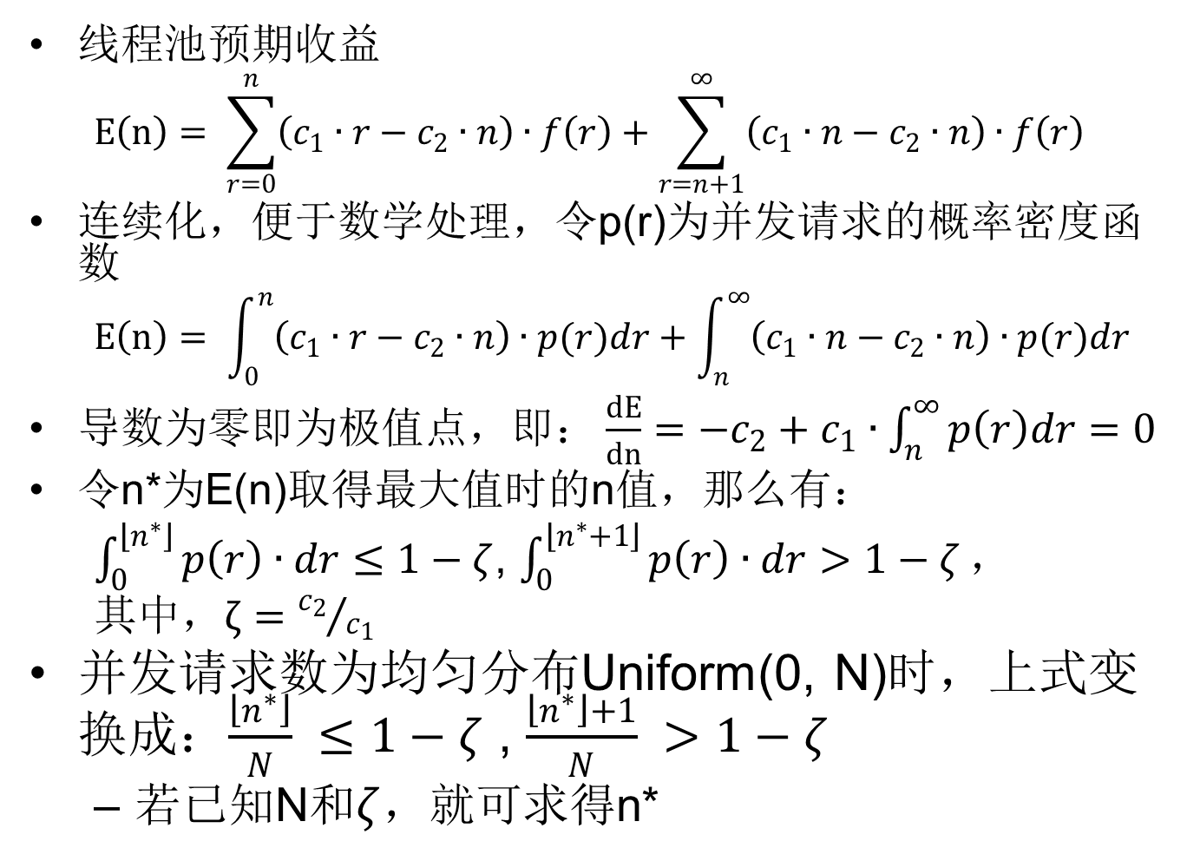
最佳线程池大小-3
线程池预期收益
$$E\left(n\right)= \sum_{r=0}^{n}{\left(c_{1}∙r−c_{2}∙n\right)∙f\left(r\right)}+\sum_{r=n+1}^{∞}{\left(c_{1}∙n−c_{2}∙n\right)∙f\left(r\right)}$$
连续化，便于数学处理，令p(r)为并发请求的概率密度函数
$$E\left(n\right)= \int_{0}^{n}{\left(c_{1}∙r−c_{2}∙n\right)∙p(r)dr}+\int_{n}^{∞}{\left(c_{1}∙n−c_{2}∙n\right)∙p(r)dr}$$
导数为零即为极值点$，即：\frac{dE}{dn}=−c_{2}+c_{1}∙\int_{n}^{∞}{p\left(r\right)dr=0}$
令n*为E(n)取得最大值时的n值，那么有：
$\int_{0}^{\left\lfloor n^{∗}\right\rfloor }{p\left(r\right)∙dr≤1−ζ}$, $\int_{0}^{\left\lfloor n^{∗}+1\right\rfloor }{p\left(r\right)∙dr>1−ζ}，$
其中$，ζ={c_{2}}/{c_{1}}$
并发请求数为均匀分布Uniform(0, N)时，上式变换成：$\frac{\left\lfloor n^{∗}\right\rfloor }{N} ≤1−ζ$ , $\frac{\left\lfloor n^{∗}\right\rfloor +1}{N} >1−ζ$
若已知N和$ζ$，就可求得n*

Slide 8
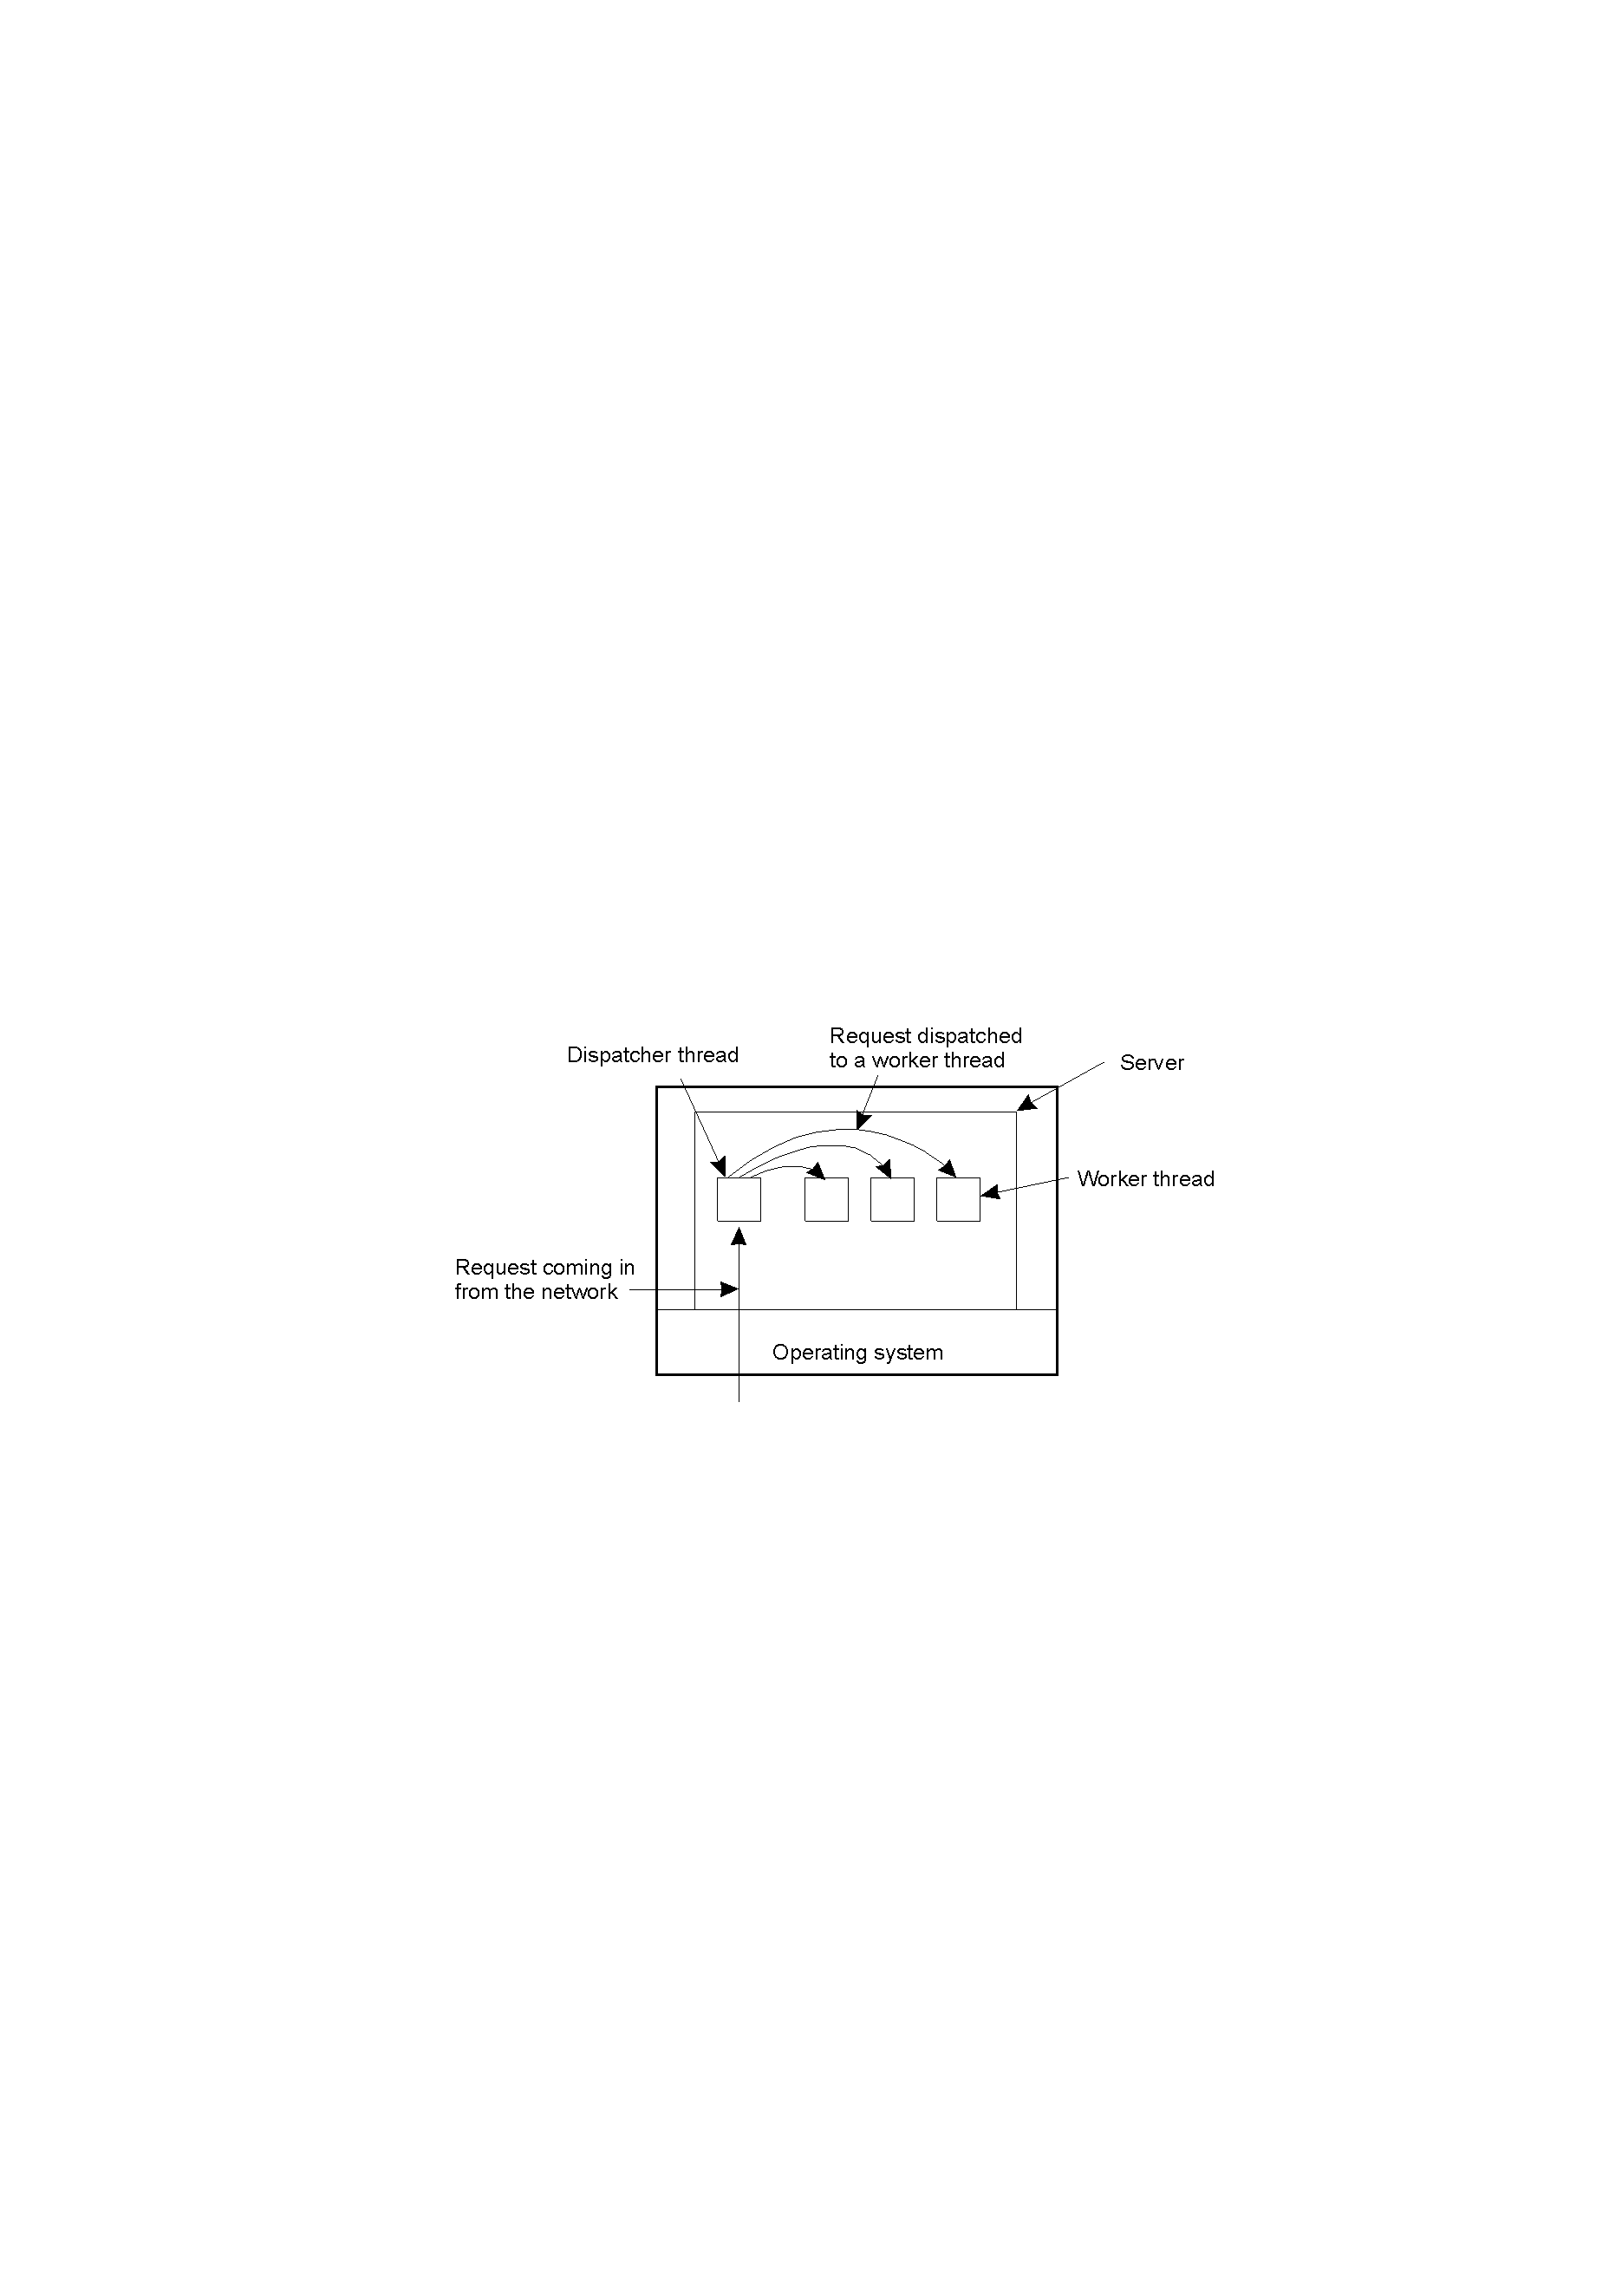
Threads in Distributed Systems
Multi-threaded Clients
Web browser
Multi-threaded Servers
Different policies with respect to threading in constructing a server
A multithreaded server organized in a dispatcher/worker model (an example of thread-per-request)
About thread origin:
A thread is created on demand
A pool of threads are maintained
About thread creating:
Implement the server with only a single thread of control
Use a separate thread for each of object (thread-per-object)
Use a separate thread for each invocation request (thread-per-request)
Use a separate thread for each client (thread-per-client)

Slide 9
2. 进程交互

Slide 10
进程交互
已有的机制
(操作系统提供的)(单机内) 进程间通信(IPC) 机制：Named Pipe, Signal, Semaphore, Shared Memory
(网络提供的)(多机间) 基于套接字(Socket)的IPC机制
分布式系统中的数据传递：基于overlay network
应用层点对点方式
应用层多播/组播方式
应用层广播方式

Slide 11
Overlay Networks
An overlay network is a virtual network that is built on top of another.
Why are they required? There are many limitations of the current Internet architecture, including the lack of security, QoS guarantees, mobility support, multicast support, end-to-end service guarantees, etc.
An overlay is built for the purpose of providing a specific application, e.g., VoIP, application layer multicast, Pub/Sub, content delivery network (CDN)
Routing overlay: provide an improved routing performance
Service overlay: provide an added service to its customers
Security overlay

Slide 12
Survey on Overlays
 | Routing Overlay | Service Overlay
One-to-One /Point-to-Point | 2. P2P Routing 5. MANET Routing | 4. Middleware Communication Protocols
One-to-many /Multicast and Broadcast | 1. Epidemic Protocols | 3. Application Level Multicasting 6. Pub/sub
Metrics
Link stress: it counts how often a packet crosses the same link
Stretch, Relative Delay Penalty (RDP): it measures the ratio in the delay between two nodes in the overlay, and the delay that those two nodes would experience in the underlying network
Notes:
3依赖1和2

Slide 13
1. Epidemic Protocols

Slide 14
Epidemic Protocols
A way to rapidly propagate information in very large-scale distributed systems using only local information
Used in applications such as failure detection, data aggregation, resource discovery and monitoring, and database replication
State of a node
Susceptible; Infective; Removed
Simple epidemic broadcast algorithm/infect-forever model: nodes are always either susceptible or infective
Propagation models
Anti-entropy
Rumor mongering: Rumor spreading/Gossiping
Strength: high scalability and reliability
Notes:
Epidemic Algorithms for Replicated Database Maintenance, 1987, ACM 6th Annual Symposium on Principles of Distributed Computing

Slide 15
Anti-Entropy Model: a kind of simple epidemics
A node P picks another Q at random, and subsequently exchanges updates with Q by one of three ways, called push, pull and push-pull.
Push: P only pushes its own updates to Q
Pull: P only pulls in new updates from Q
Push-Pull: P and Q send updates to each other
Round: define a round as spanning a period in which every node will at least once have taken the initiative to exchange updates with a randomly chosen other node.

Slide 16
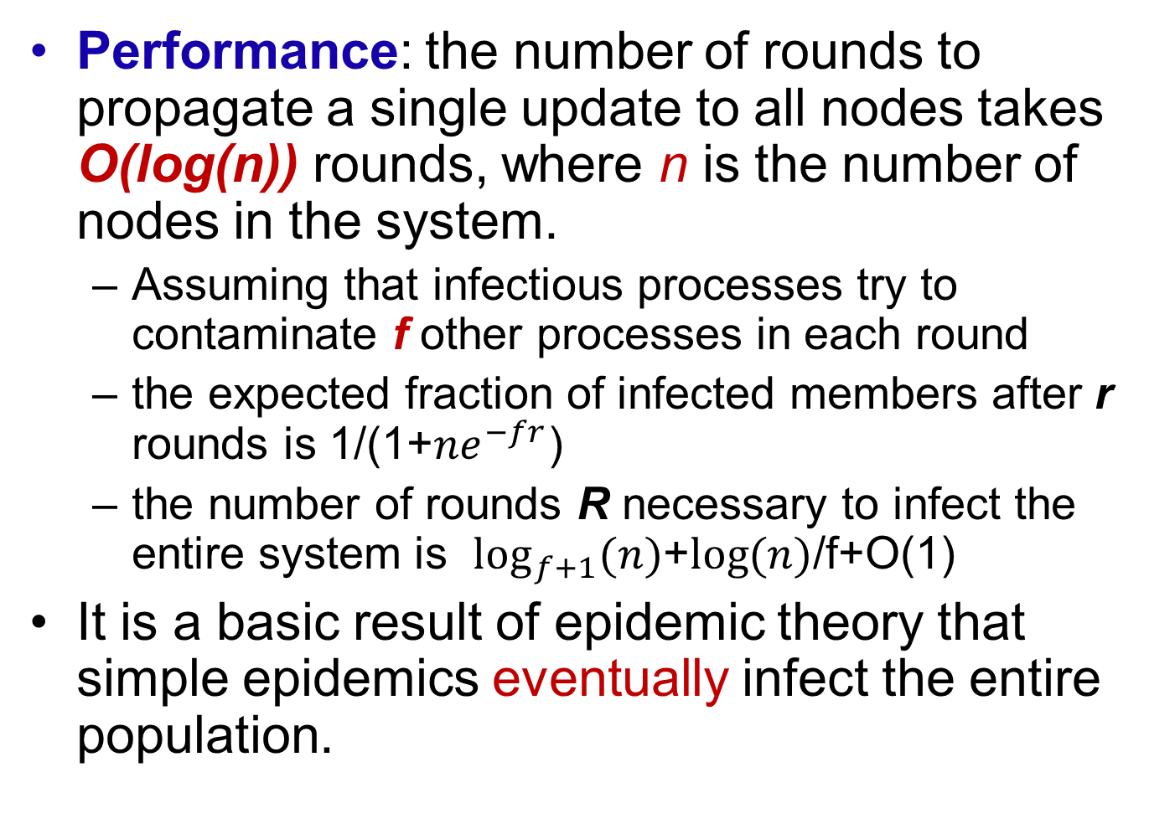
Anti-Entropy Model: an infect-forever model
Performance: the number of rounds to propagate a single update to all nodes takes O(log(n)) rounds, where n is the number of nodes in the system.
Assuming that infectious processes try to contaminate f other processes in each round
the expected fraction of infected members after r rounds is 1/(1+${ne}^{−fr}$)
the number of rounds R necessary to infect the entire system is $\log_{f+1}{(n)}$+$\log{(n)}$/f+O(1)
It is a basic result of epidemic theory that simple epidemics eventually infect the entire population.

Slide 17
Anti-Entropy Model: Push versus Pull
Let p_{i} be the probability of a site's remaining susceptible after the i-th round of anti-entropy.
For pull, a site remains susceptible after the i+1st round if it was susceptible after the i-th round and it contacted a susceptible site in the i+1st round. Thus, p_{i+1} = (p_{i})²
For push, a site remains susceptible after the i+1st round if it was susceptible after the i-th round and no infectious site chose to contact it in the i+1st round. Thus, p_{i+1} = p_{i} *(1-(1/n))^{n(1-pi)} ≈ p_{i} *e⁻¹
Either pull or push-pull is greatly preferable to push

Slide 18
Gossiping - I
n individuals, initially inactive (susceptible).
We plant a rumor with one person who becomes active (infective), phoning other people at random and sharing the rumor
Every person hearing the rumor also becomes active and likewise shares the rumor
When an active individual makes an unnecessary phone call (the recipient already knows the rumor), then with probability 1/k the active individual loses interest in sharing the rumor
the individual becomes removed

Slide 19
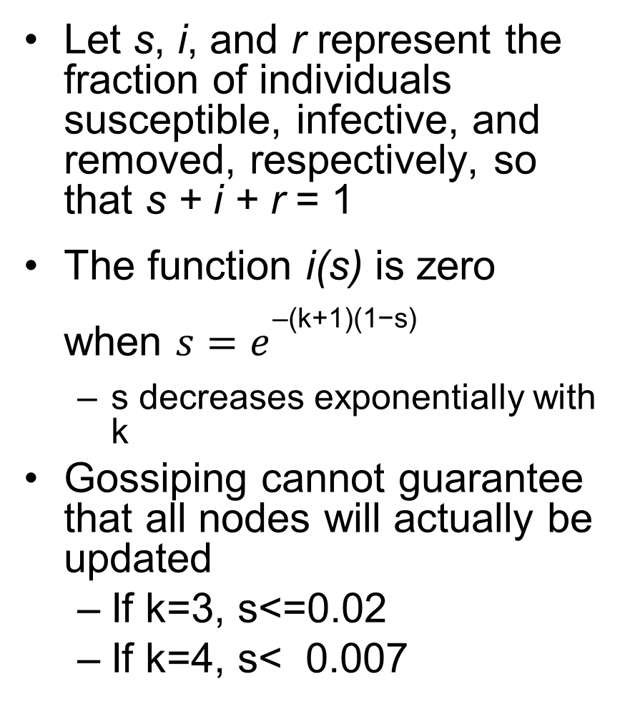
Gossiping - II
Let s, i, and r represent the fraction of individuals susceptible, infective, and removed, respectively, so that s + i + r = 1
The function i(s) is zero when ${s=e}^{\text{–(}\text{k}\text{+1)(1−}\text{s}\text{)}}$
s decreases exponentially with k
Gossiping cannot guarantee that all nodes will actually be updated
If k=3, s<=0.02
If k=4, s< 0.007
Increasing k is an effective way of insuring that almost everybody hears the rumor

Slide 20
Gossiping - III
Side-effect: spreading the deletion of a data item is hard.
Cause: the deleted data are interpreted as updates on something the server did not have before.
Solution: introduce and spread death certificates. Death certificates need to be cleaned up regularly.
Parameters in epidemic dissemination :
n: the size of a system
b: the capacity of message buffer
t: the times of message forwarding
f: the size of processes selected randomly for forwarding messages

Slide 21
2. P2P Routing

Slide 22
P2P Lookup/Routing
Functional requirements
Locate and communicate with any individual resource
Add new resources or remove them at will
Add hosts or remove them at will
Provide simple APIs to store and find data
Typical DHT interface: put(key, value), get(key) → value
Non-functional requirements
Global scalability
Load balancing
Accommodating to highly dynamic host availability
Optimization for local interactions between neighboring peers
Security of data in an environment with heterogeneous trust
Anonymity, deniability and resistance to censorship

Slide 23
Pastry: Prefix Routing
所有结点和对象都被分配了一个128位的GUID(Globally Unique IDentifiers)值(用16进制表示)，它随机分布在区间[0, 2¹²⁸ - 1]
每个活结点都保存一个叶子集合(leaf set)，叶子集合是一个大小为2l的向量L， L包含有和当前结点GUID相邻的2l个(l个大于，l个小于)其他结点的GUID和结点IP地址
在一个具有N个结点参与的网络中，Pastry路由算法能够在O(log N)步内正确地将消息路由到任何GUID对应的地址上

Slide 24
Circular routing alone is correct but inefficient
The dots depict live nodes.
The space is considered as circular: node 0 is adjacent to node (2¹²⁸-1).
The diagram illustrates the routing of a message from node 65A1FC to D46A1C using leaf set information alone, assuming leaf sets of size 8 (l = 4).
This is a degenerate type of routing that would scale very poorly; it is not used in practice.

Slide 25
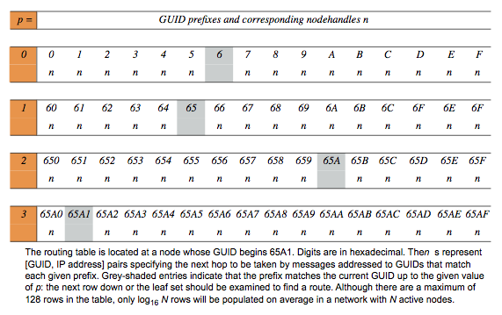
Routing table R in Pastry
路由表：路由表的行数和一个GUID的16进制表示的位数相同，因此，路由表有128/4＝32行

Slide 26
Routing process at any node A to node D
≠
p

Slide 27
结点加入：假设新结点的GUID是X，并且它所联系的附近结点的GUID为A
结点X发送一个专门的连接请求消息给结点A，并且这个消息的目标地址被设为X。这样，结点A按正常的方式通过Pastry分发这个消息，假设路由连接消息路途上的结点有B，C。Pastry将会把这个连接请求消息发送到那些已经存在于系统中并且与X接近的结点上去；我们不妨把这些结点称为Z
X的路由表：A是X的一个邻居结点，从而结点A的路由表的第一行将是结点X路由表的第一行(X0)的首选。另一方面，对于结点X路由表的第二行(X1)来说，结点A的路由表可能与X1是不相关的了，因为结点X的GUID和结点A的GUID它们的十六进制形式的第一位并不相同。不过，路由算法可以确保结点X的GUID和结点B的GUID的第一位是相同的，这也意味着，结点B路由表的第二行(B1)对于X1(结点X路由表的第二行)来说是合适的首选。相似的，结点C路由表的第三行(C2)对于结点X路由表的第三行(X2)来说是合适的首选，其他的以此类推
X的叶子集合：既然结点Z的GUID从数值上接近结点X的GUID，那么X的叶子集合应该和Z的叶子集合是相似的。事实上，理想化的X的叶子集合与Z的叶子集合只有一个成员不同。因此Z的叶子集合对于X来说是一个足够好的近似
X将路由表和叶子集合的信息发送给路由表和叶子集合中的所有结点，相关结点接收到X的信息，然后调整它们的路由表或叶子集合

Slide 28
结点失效：当某个结点发现有结点失效时，
为了修复自身的叶子集合L，它找到靠近失效结点的某个活结点，然后从这个邻居结点中获得它叶子集合L’的一份拷贝，L’中包含一部分与L重叠的GUID，其中有一个合适的代替失效结点的结点。别的相邻结点也会收到有结点失效的通知，然后这些结点执行上述类似的操作，以修复它们的叶子集合。这个修复过程能够保证结点的叶子集合可以得到修复，除非结点中的l个连续的相邻结点同时失效
对路由表的修复基于“一旦发现”机制。即使一些路由表项不再有效，消息的路由仍能继续进行：如果路由失败，那么将使用路由表同一行的其他项
使用一个简单的闲聊(gossip)协议来定期在结点之间交换路由表信息，从而修复路由表失效的项，并避免地域特性的缓慢退化。闲聊协议每隔20分钟运行一次
性能(Pastry的可靠版本MSPastry)：RDP (Relative Delay Penalty)值在网络消息丢失率为0％情况下约为1.8，在网络消息丢失率为5％情况下约为2.2

Slide 29
3. Application Layer Multicasting

Slide 30
Application Layer Multicasting
The crucial design issue is the construction of the overlay network
Nodes are organized into a tree or a mesh network
Metrics: link stress, stretch, tree cost
Link stress: it counts how often a packet crosses the same link.
Stretch, Relative Delay Penalty (RDP): it measures the ratio in the delay between two nodes in the overlay, and the delay that those two nodes would experience in the underlying network.
Tree cost: it is generally related to minimizing the aggregated link costs
Examples: ESM (End System Multicast), Scribe

Slide 31
ESM (End System Multicast)
Goal:
To provide the real-time multicasting of video over the Internet
To seek resilience to changes through self-organization, e.g., to deal gracefully with dynamic joining and leaving by nodes, failure of nodes and changes in the configuration and performance of the underlying network
Solution: constructing a tree for each video stream, rooted in the source of that particular stream
Key elements:
how to maintain membership information: gossip protocol;
how to deal with new peers joining the tree;
how to deal with peers leaving the tree (whether gracefully or through failure);
how to adapt the tree structures for performance.

Slide 32
Joining a tree
A new node that wants to join contacts the source node (the root of the tree) and is given a randomly selected set of nodes taken from the group view maintained by the source. The new node must select an appropriate parent from this set.
Step 1: The new node probes the set of members provided by the source and collects the following information on each candidate:
the performance that node is currently receiving in terms of the throughput and latency from the source;
the saturation of that node in terms of the number of children it already supports.
Step 2: The new node eliminates candidates that it deems saturated and then calculates the service it can expect from each of the other candidates in terms of throughput and delay.
node selection is based on throughput
and then delay
S
A
E
G
B
C
D
F

Slide 33
Dealing with nodes leaving
Members can leave a tree either through (a) an explicit leave request or through (b) failure.
(a) The leaving member notifies children that it is leaving and is then expected to keep forwarding data for a period to avoid disruption of service further down the tree.
(b) Members periodically send alive messages to their children and failure is detected when these messages are not received.
All the children must invoke the parent selection procedure, with extra checks carried out to ensure candidates are not already descendants of the given nodes.
S
A
E
G
B
C
D
F

Slide 34
Performance-aware adaptation
Each node continually monitors the service it is getting from its parent node. Adaptation is triggered if the detected rate drops significantly below the expected rate from the source.
To avoid thrashing, a node must wait for a particular period, known as the detection time, before electing to adapt.
Once a decision is made to adapt, the node will invoke the parent selection algorithm to determine a new, more optimal parent. In this way, the tree construction is constantly re-evaluated and will self-organize to optimize overall performance.
S
A
E
G
B
C
D
F

Slide 35
Scribe: an application level multicast infrastructure
Scribe is built on top of Pastry, an object location and routing scheme
Each group has a unique groupId. The Scribe node with a nodeId numerically closest to the groupId acts as the rendezvous point for the associated group. The rendezvous point is the root of the multicast tree created for the group
Scribe nodes that are part of a group’s multicast tree are called forwarders with respect to the group
Scribe scales across a wide range of groups and group sizes. Also, it balances the load on the nodes while achieving acceptable delay and link stress when compared with Internet protocol multicast

Slide 36
Functionality of Scribe
Creating a group
Joining a group
Leaving a group
Maintaining the tree: Parent sends heartbeat messages to check if nodes are alive
Repairing the tree
A multicast tree

Slide 37
Creating a group (1100)
1111
0100
GroupID | 1100
ACL | xxx
Parent | Null
1100
1101
Rendezvous Point
1001
(the root of the multicast tree)
Group Creator
creates Group 1100
0111

Slide 38
Joining a group
GroupID | 1100
Parent | 1001
Child | 0100
1111
0100
GroupID | 1100
ACL | xxx
Parent | Null
1100
1101
GroupID | 1100
Parent | 1100
Child | 1001
Join request
GroupID | 1100
Parent | 1001
Child | 0111
Rendezvous Point
1001
(Pastry root)
GroupID | 1100
Parent | 1101
Child | 0100
0111
P
Joining member
Child 0111

Slide 39
Multicasting
1111
Message
0100
1100
1101
Multicast down tree
Rendezvous Point
1001
(Pastry root)
0111

Slide 40
Leaving a group
1111
0100
GroupID | 1100
ACL | xxx
Parent | Null
Child | 1101
1100
1101
1001
Leave request
GroupID | 1100
Parent | 1001
Rendezvous Point
Member
(Pastry root)
GroupID | 1100
Parent | 1100
Child | 1001
GroupID | 1100
Parent | 1101
0111
P
Leaving member

Slide 41
Repairing the tree
GroupID | 1100
Parent | 1001
Child | 0100
GroupID | 1100
Parent | 1100
Child | 1001
1111
Join request
0100
Join request
1100
1101
Rendezvous Point
Failed Node
1001
(Pastry root)
GroupID | 1100
Parent | 1111
Child | 0100
Child | 0111
GroupID | 1100
ACL | Xxx
Parent | Null
Child | 1111
0111
GroupID | 1100
Parent | 1001
Child | 0111

Slide 42
Summary
Problems with Scribe
Best-effort delivery
No built-in protection of information
Possible concurrency problems
Comparing Scribe and IP multicast
Scribe scales better and supports dynamic groups
Scribe nearly as efficient as IP multicast

Slide 43
4. Middleware Communication Protocols

Slide 44
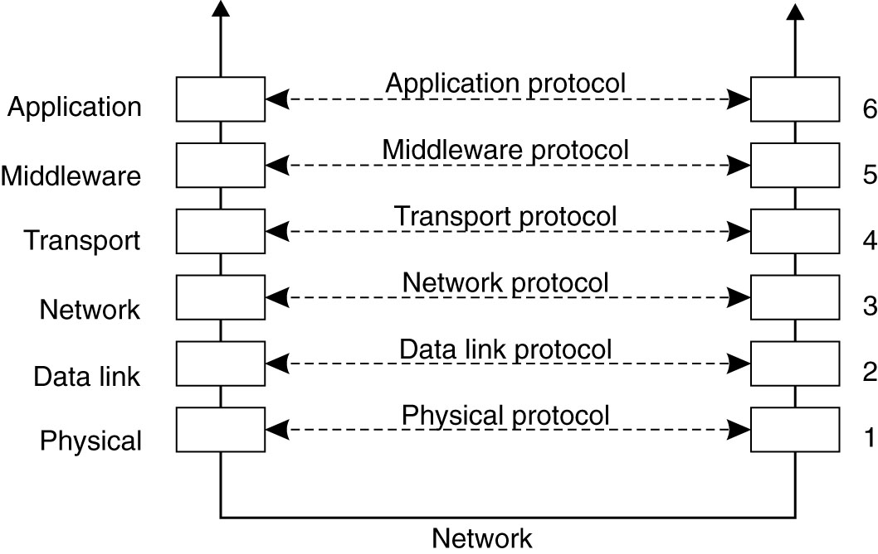
Middleware Communication Protocols
Remote Procedure Call (RPC)
Remote Method Invocation (RMI)
Message-Oriented Middleware (MOM)
Stream-Oriented Communication

Slide 45
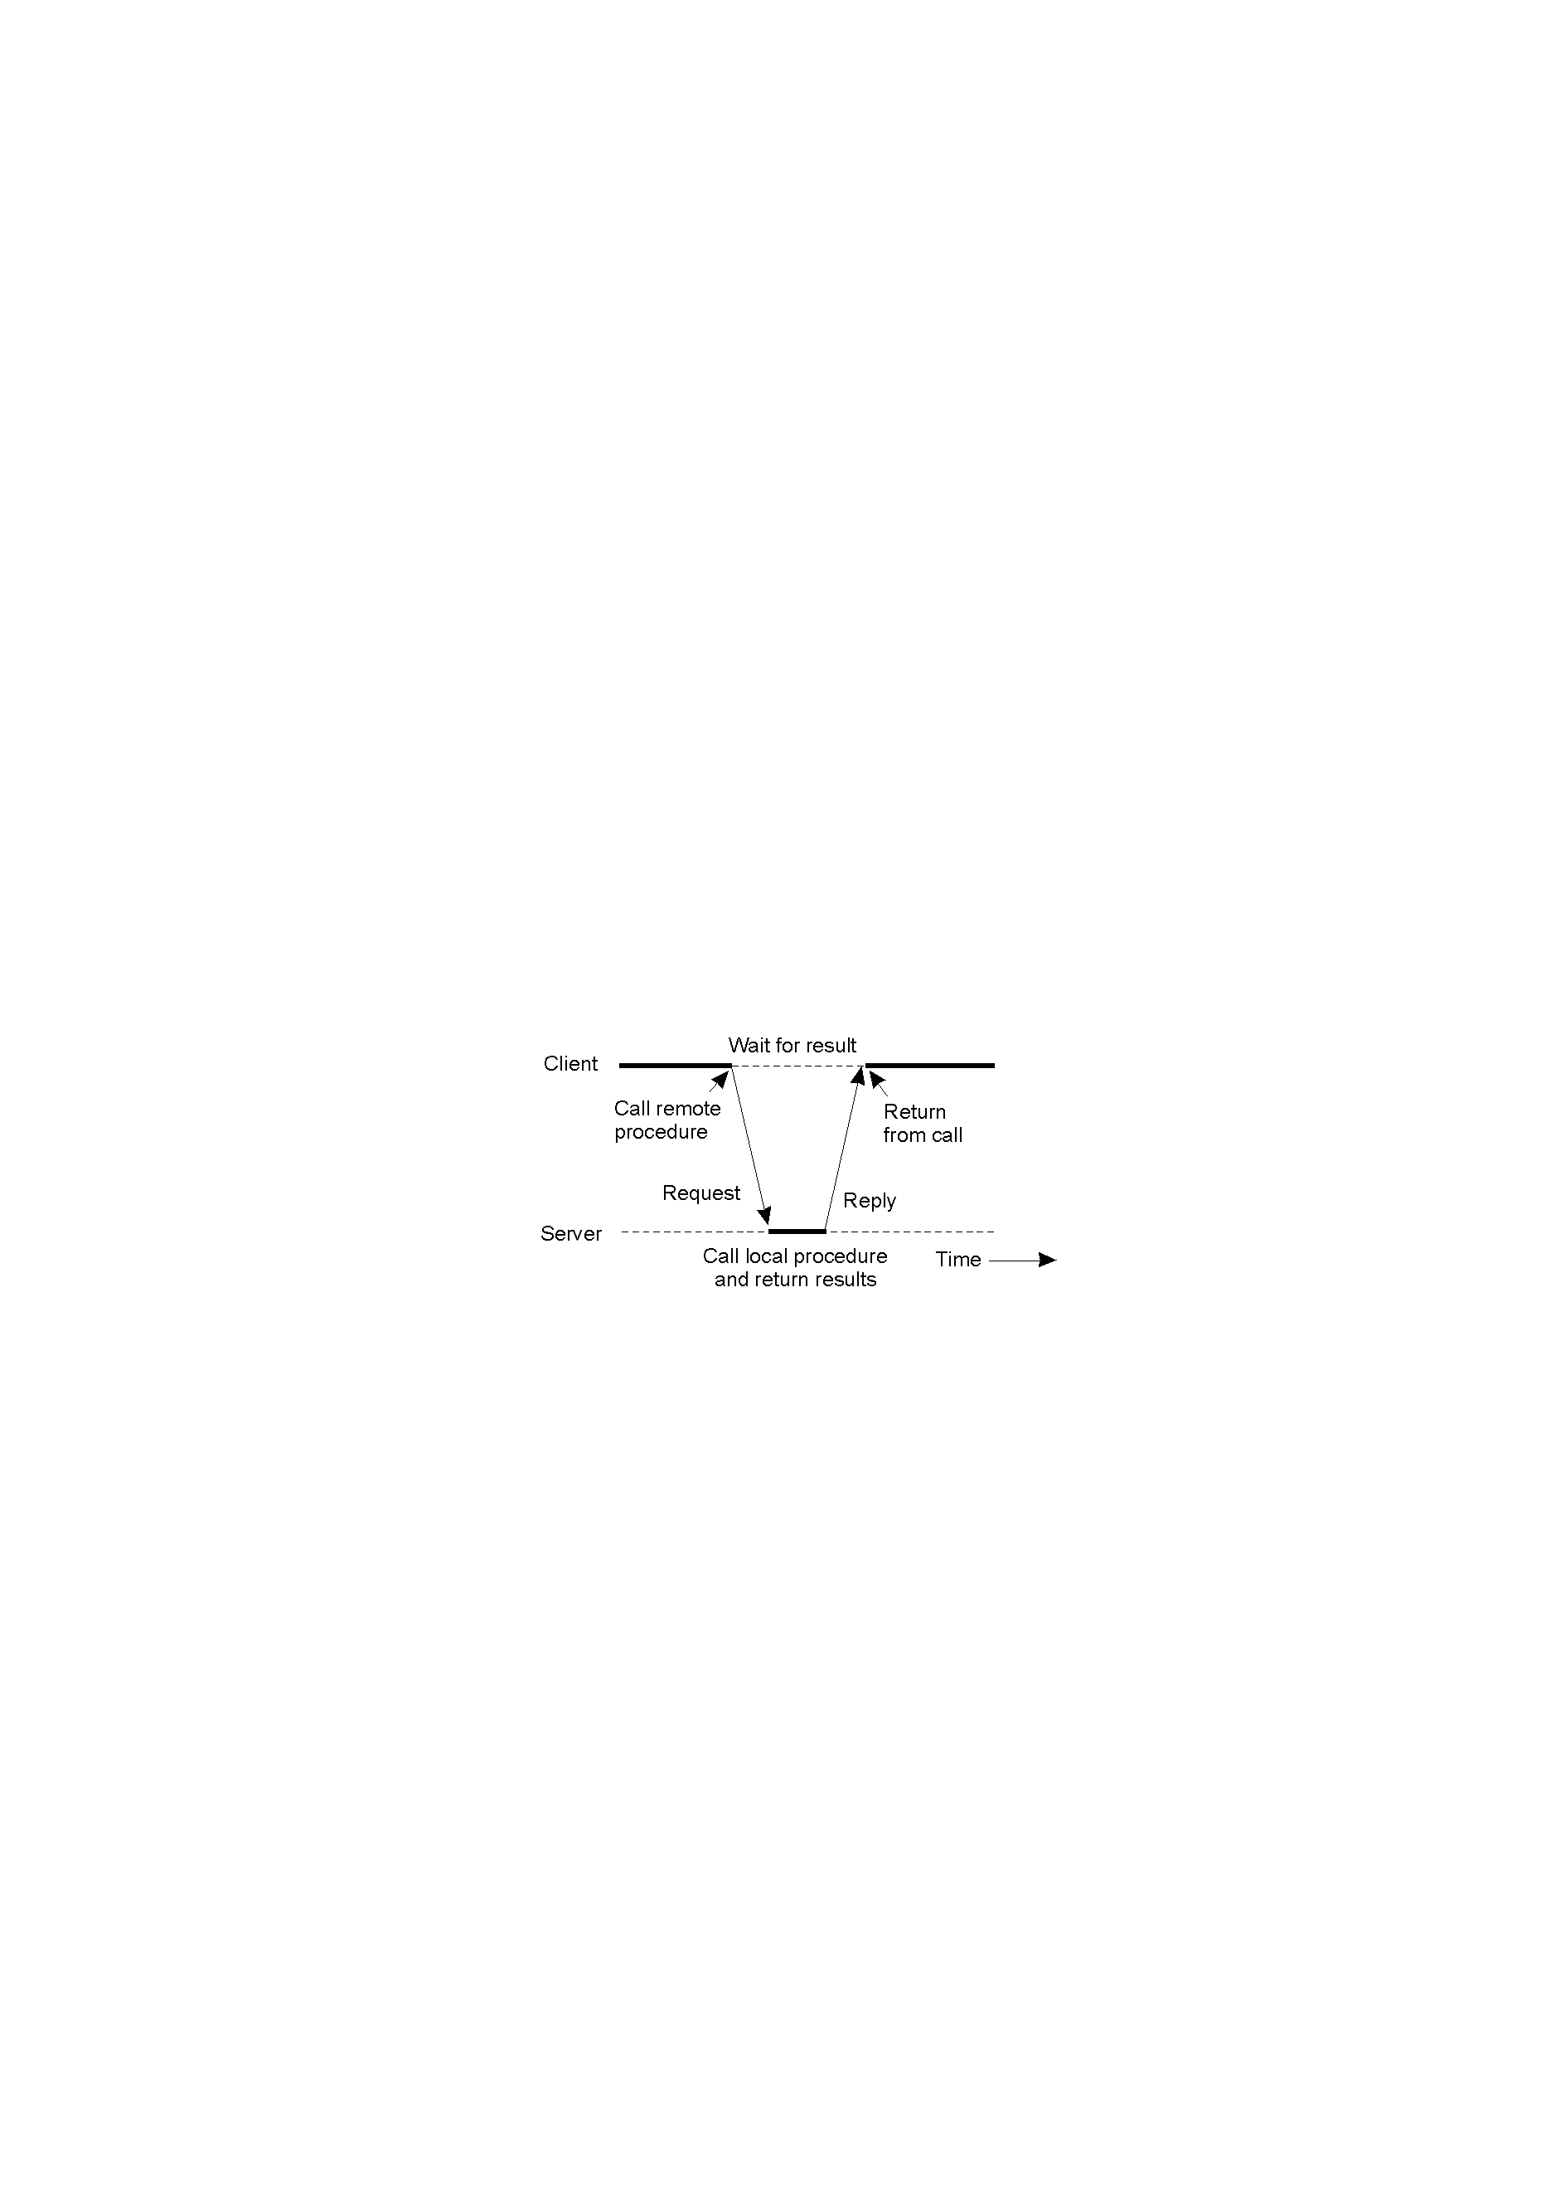
Remote Procedure Calls
Idea inferred from conventional procedure call
Allowing programs to call procedures located on other machines
Achieve transparency: access and location transparency
How to implement the calling ?
Parameter passing mechanism?
RPC semantics ?
How to deal with the failures?

Slide 46
Steps of a Remote Procedure Call
Client procedure calls client stub in normal way
Client stub builds message, calls local OS
Client's OS sends message to remote OS
Remote OS gives message to server stub
Server stub unpacks parameters, calls server
Server does work, returns result to the stub
Server stub packs it in message, calls local OS
Server's OS sends a message to client's OS
Client's OS gives a message to client stub
Stub unpacks result, returns to client

Slide 47
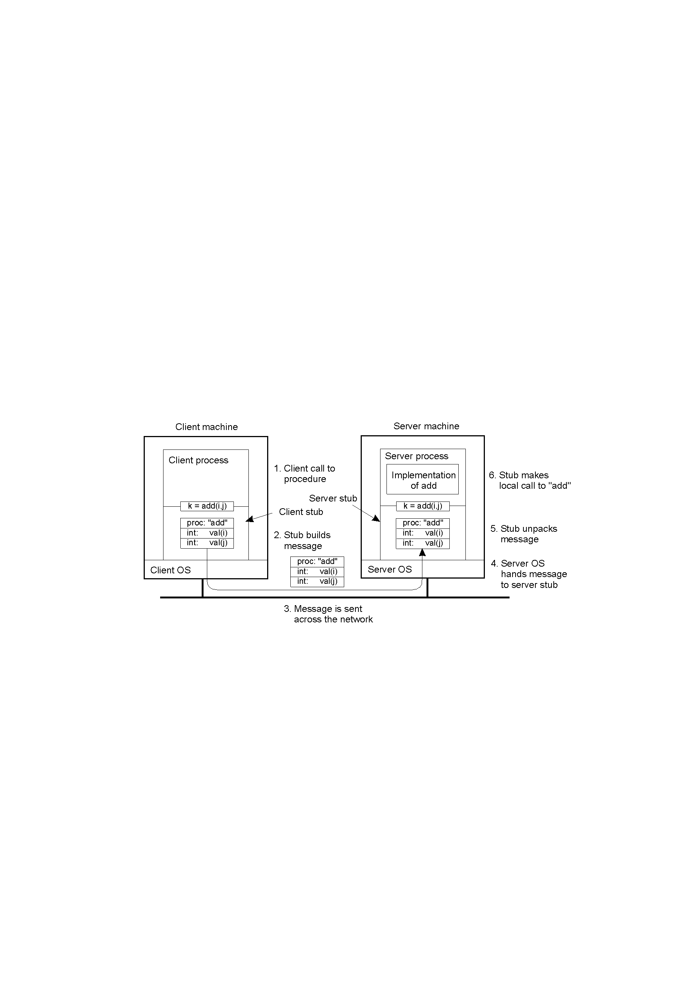
Example of a Remote Procedure Call
Steps involved in doing remote computation through RPC

Slide 48
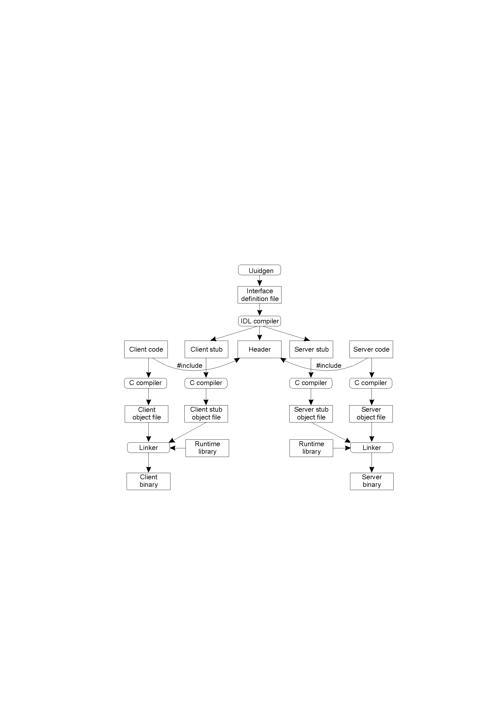
Case Study: DCE RPC
The steps in writing a client and a server in DCE RPC.

Slide 49
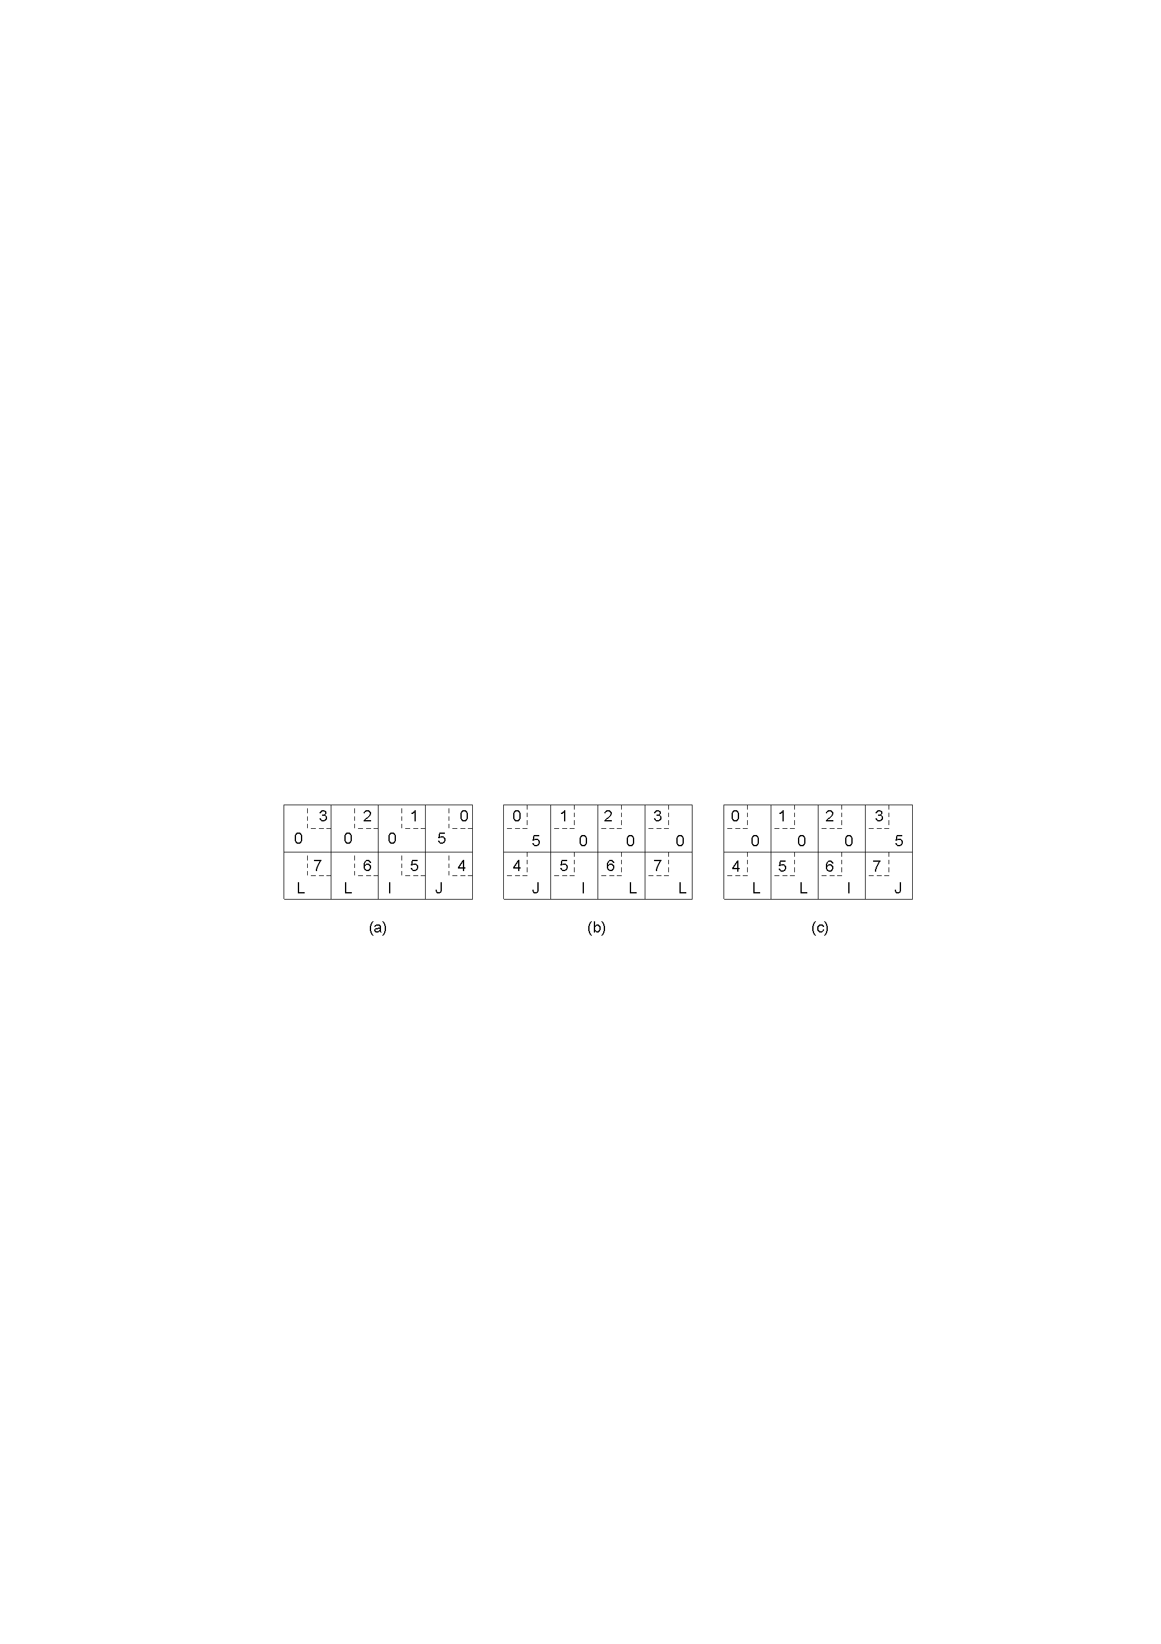
Parameter Passing
Different Encoding: EBCDIC versus ASCII
Different Endianness
Reference Parameter Passing:
call-by-reference has been replaced by copy/restore
Original message on the Pentium - 5 JILL
The message after receipt on the SPARC
The message after being inverted. The little numbers in boxes indicate the address of each byte

Slide 50

Parameter Passing: Parameter Specification
Define message format:
Agree on the representation of simple data structures
Agree on the service of data transport
A procedure b)The corresponding message.

Slide 51
RPC Semantics
At least once semantics
At most once semantics
Maybe — Guarantee nothing
Can RPC have the exactly once semantics similar to the local calls? No.
Fault tolerance measures
Invocation semantics
Retransmit request
Duplicate
Re-execute procedure
message
filtering
or retransmit reply
No
Not applicable
Not applicable
Maybe
Yes
No
Re-execute procedure
At-least-once
Yes
Yes
Retransmit reply
At-most-once

Slide 52
Failures that can occur in RPC Systems
The client is unable to locate the server.
The request message from the client to server is lost.
The server crashes after receiving a request.
The reply message from the server to the client is lost.
The client crashes after sending a request.

Slide 53
RPC Failures and Solutions (1)
Client cannot locate the server
to have the error raise an exception (e.g., Java)
to use signal handlers (e.g., defining a signal type SIG-NOSERVER)
Drawbacks: not every language has exceptions or signal handlers, and that will destroys the transparency we have been trying to achieve.
Lost request message
start a timer at client stub, if the timer expires before a reply or acknowledgement comes back, the message is sent again.

Slide 54
RPC Failures and Solutions (2)
Server crashes
client sets a timer and the timer expires
its solution depends on RPC semantics:
at least once semantics: client stub reissues request and server re-executes it
at most once semantics: client stub gives up immediately and reports failure
maybe semantics: guarantee nothing

Slide 55
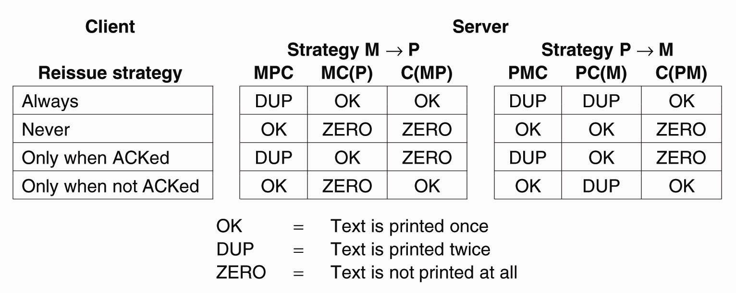
Example
Server’s Task:
M: send the message to client
P: print some text
C: crash
(Reboot after crashing)
Notes:
第一行：符合at-least once语义
第二行：符号at-most once语义

Slide 56
RPC Failures and Solutions (3)
Lost Reply Messages
client stub sets a timer and the timer expires
send the request once more
idempotent and un-idempotent requests
client assigns each request a sequence number
at-least-once semantics: resend the request, re-execute it
at-most-once semantics: resend the request, filter the duplicated request, retransmit the reply (if any)/re-execute it

Slide 57
Client Solutions for RPC Failures
检测手段 | 原因 | 解决方案
连不上服务器 | 客户不能 定位服务器 | 抛异常
超时 (能连上服务器) | 请求丢失 | 重发请求
超时 (不能连上服务器) | 服务器崩溃 | (服务器重启后)重发 +(服务器)重执行/at-least-once
 |  | 抛异常/at-most-once
超时 (能连上服务器) | 应答丢失 | 重发+ (服务器)重执行(幂等操作)/at-least-once
 |  | 重发+ (服务器)过滤+重传应答/重执行/at-most-once

Slide 58
RPC Failures and Solutions (4)
Client crashes
Orphan & grand-orphan: a computation is active and no parent is waiting for result.
extermination: the client stub makes a log entry before sending a RPC message, and kill the orphan after being rebooted
reincarnation: the client broadcasts a message after restart, so servers kill all remote computation on behalf of that client
gentle reincarnation: the client broadcasts a message, so servers try to locate their owner and kill it if the owner cannot be found.
expiration: each RPC is given a standard amount of time, if it cannot finish in the specified period, it must explicitly ask for another quantum
In practice, none of these methods are desirable

Slide 59
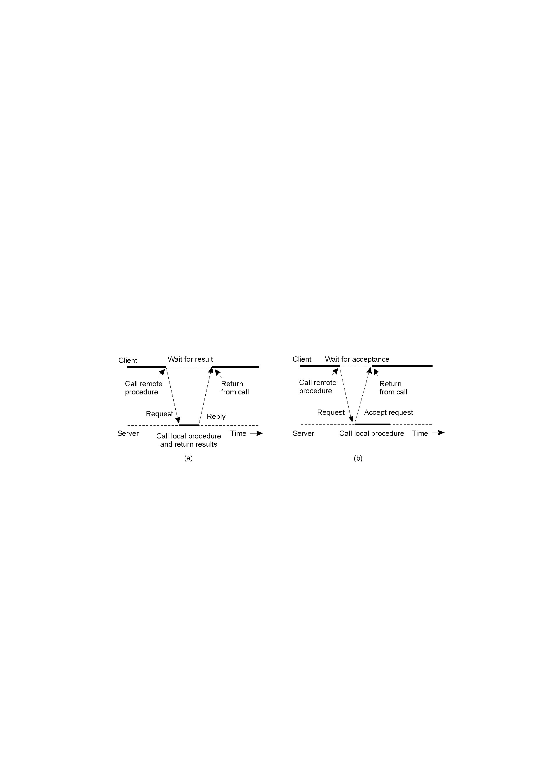
Extended RPC Models: Asynchronous RPC -1
a) The interconnection between client and server in a traditional RPC
b) The interaction using asynchronous RPC
Server immediately sends a reply back to the client the moment the RPC request is received

Slide 60
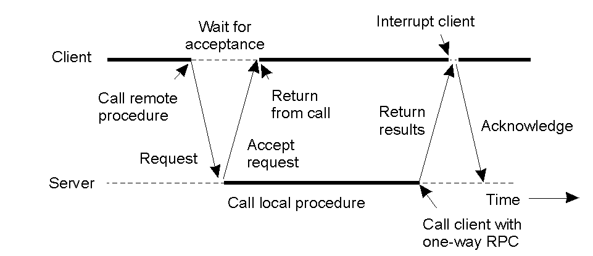
Extended RPC Models:Asynchronous RPC-2
Deferred Synchronous RPC: A client and server interacting through two asynchronous RPCs

Slide 61
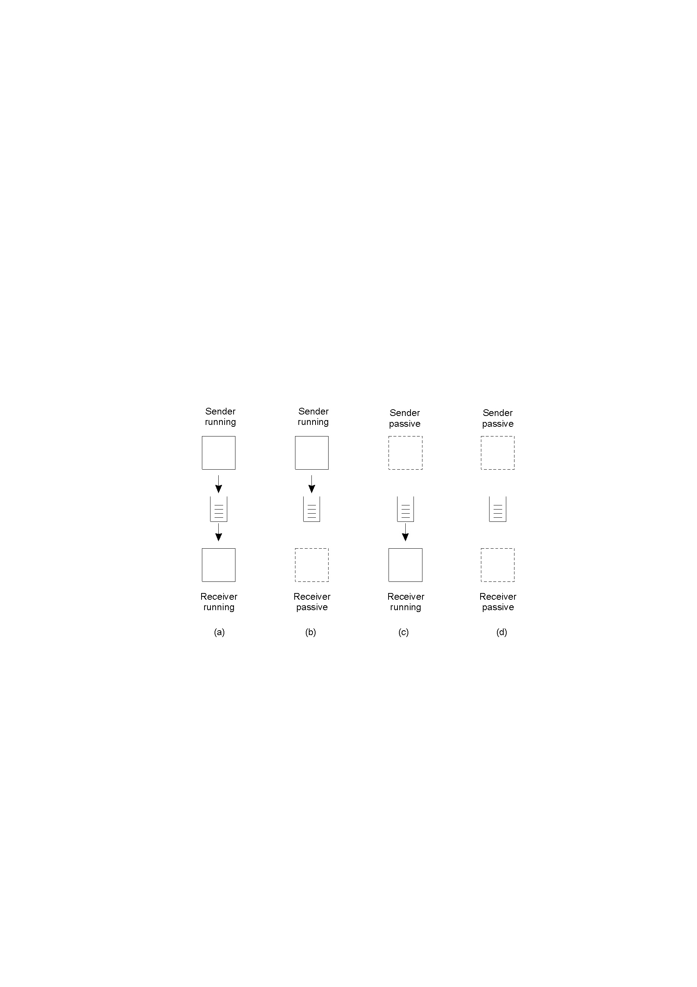
Message-oriented Middleware
Message-oriented middleware (Message-queuing systems) provide message-oriented persistent asynchronous communication, offering intermediate-term storage capacity for messages, without requiring either the sender or receiver to be active during message transmission
Message-Queuing Model:
Four combinations for loosely-coupled communications using queues.

Slide 62
Comparing MOMs with e-mail systems
MOM is more general, used for data integration
Email systems provide direct support for end users such as automic message filtering, but not providing guaranteed message delivery, message priorities, efficient multicasting, load balancing, fault tolerance, etc.

Slide 63
Basic Interface for a Message-Queuing System
Queue:
Transient queue, persistent queue, transactional queue;
Local queue, remote queue;
Source queue, destination queue
Primitive | Meaning
Put | Append a message to a specified queue
Get | Block until the specified queue is nonempty, and remove the first message
Poll | Check a specified queue for messages, and remove the first. Never block.
Notify | Install a handler to be called when a message is put into the specified queue.
Basic interface to a queue in a message-queuing system.

Slide 64
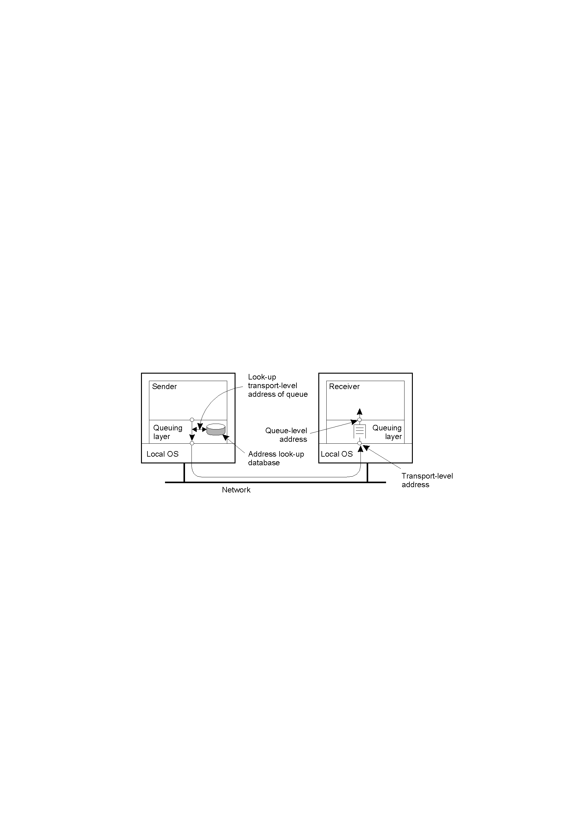
General Architecture of a Message-Queuing System-1
Queue Manager
The relationship between queue-level addressing and network-level addressing.

Slide 65
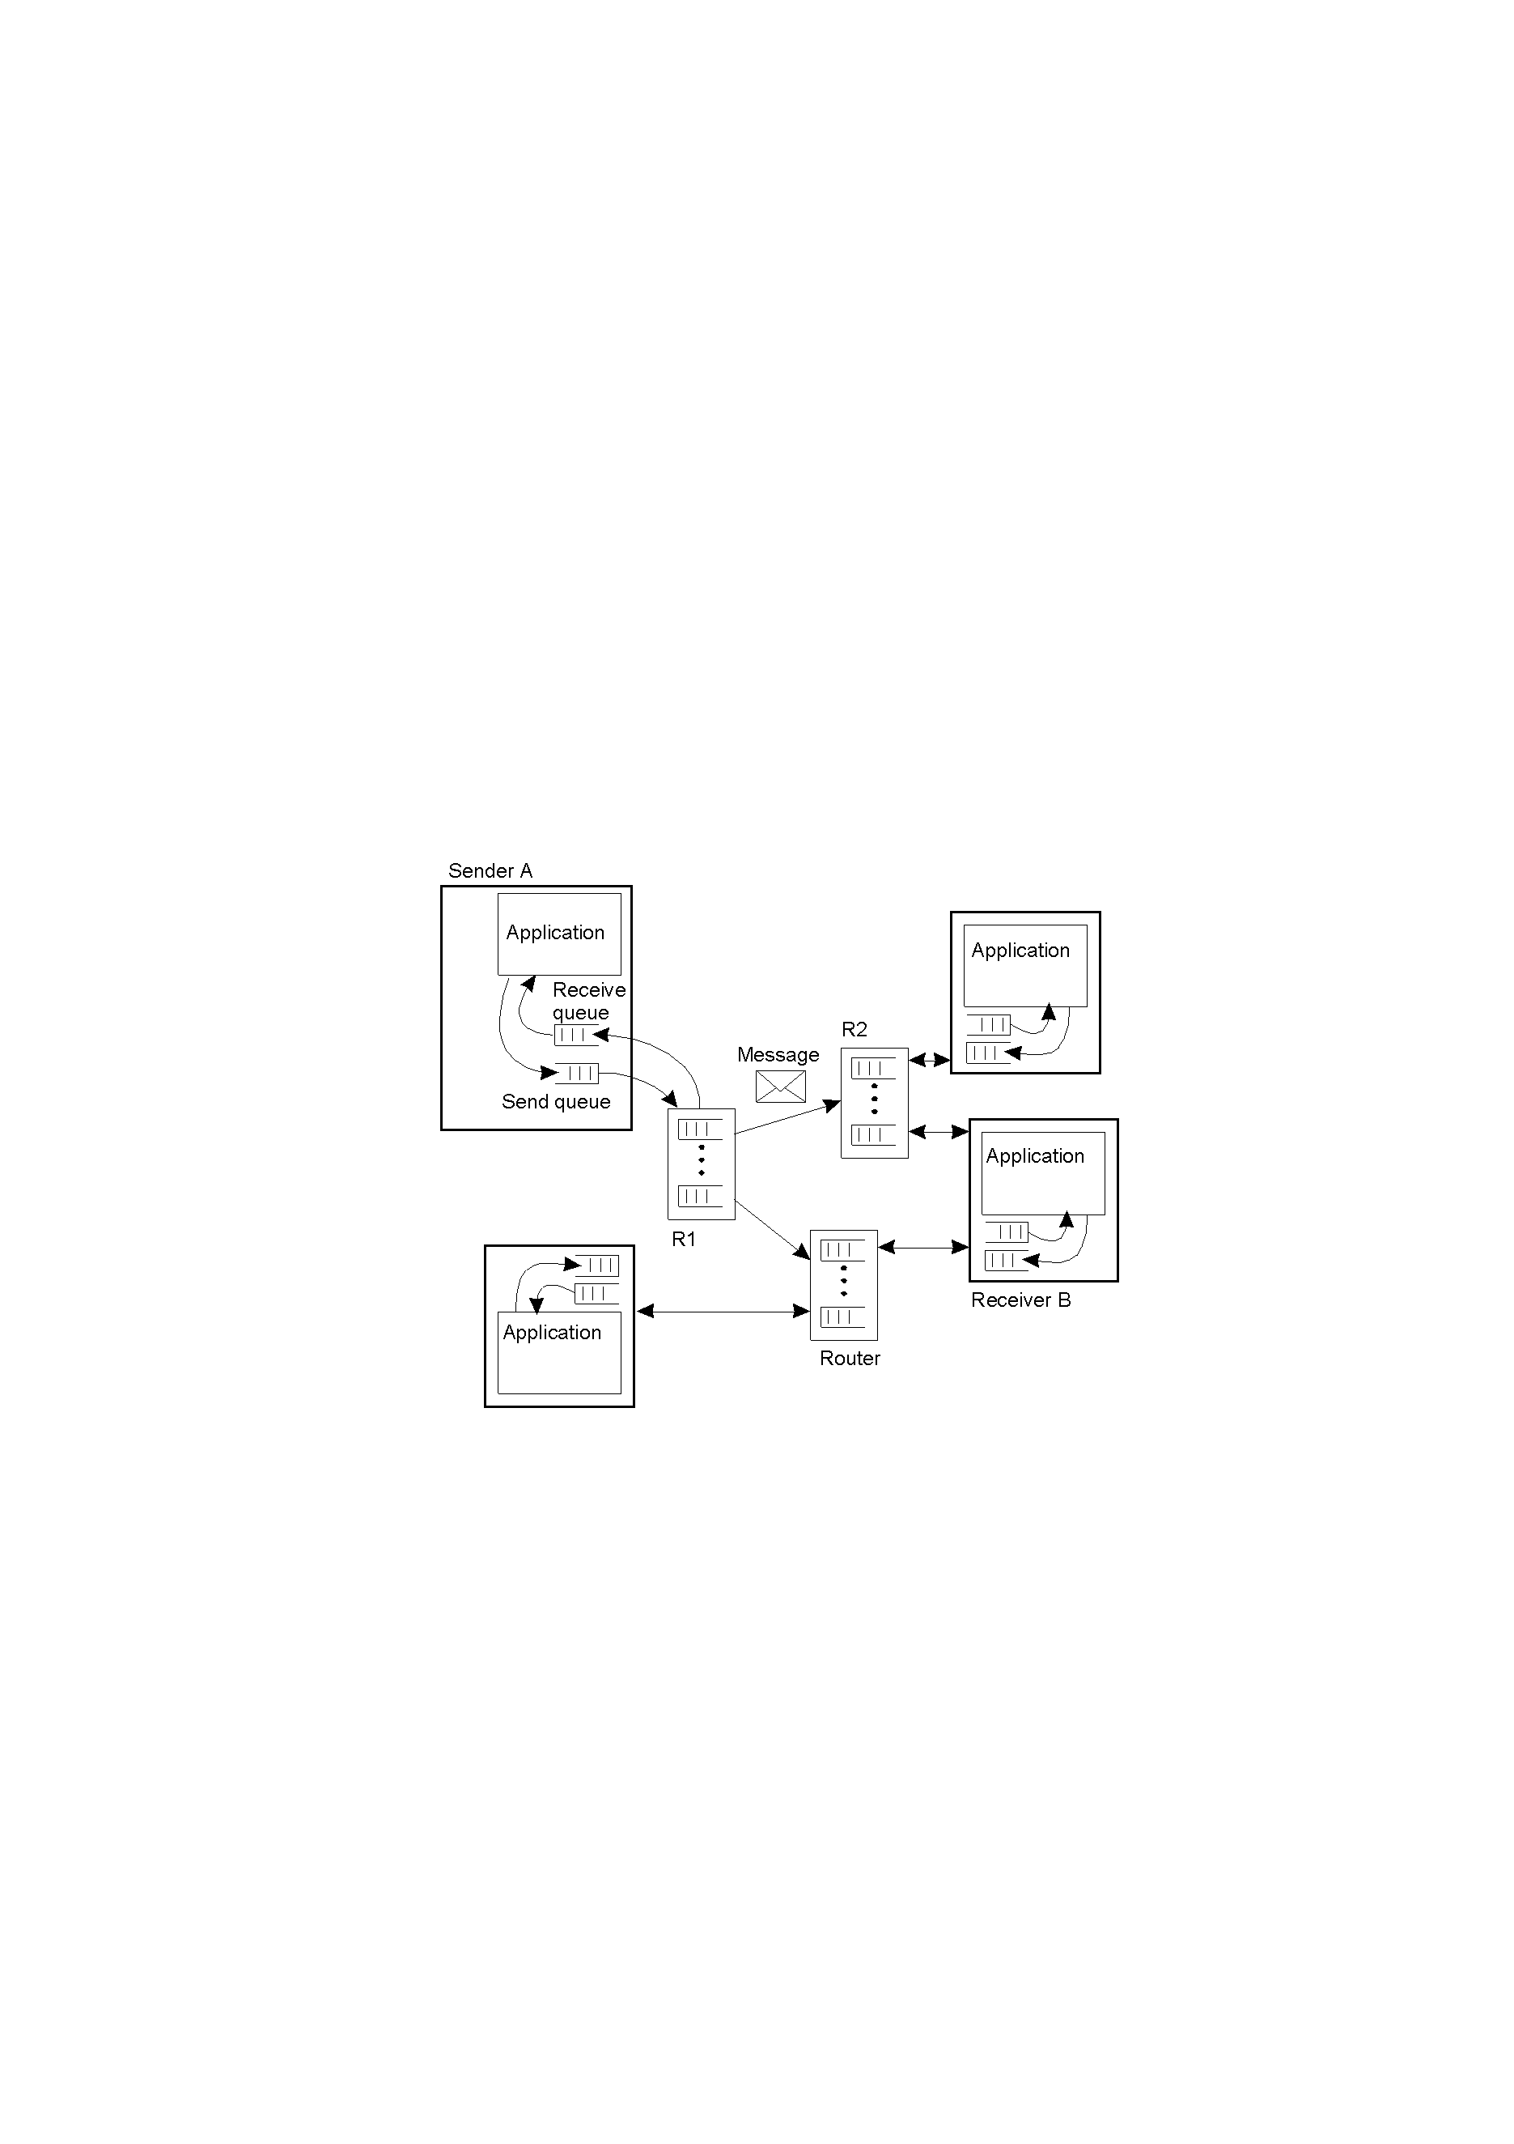
General Architecture of a Message-Queuing System (2)
Two ways of addressing:
Maintain a mapping of queues to network locations in every queue manager;
Add routers that know about the network topology (for scalable MOM).
MOM ➔ a complete, application-level overlay network on top of an existing computer network
The general organization of a message-queuing system with routers.

Slide 66
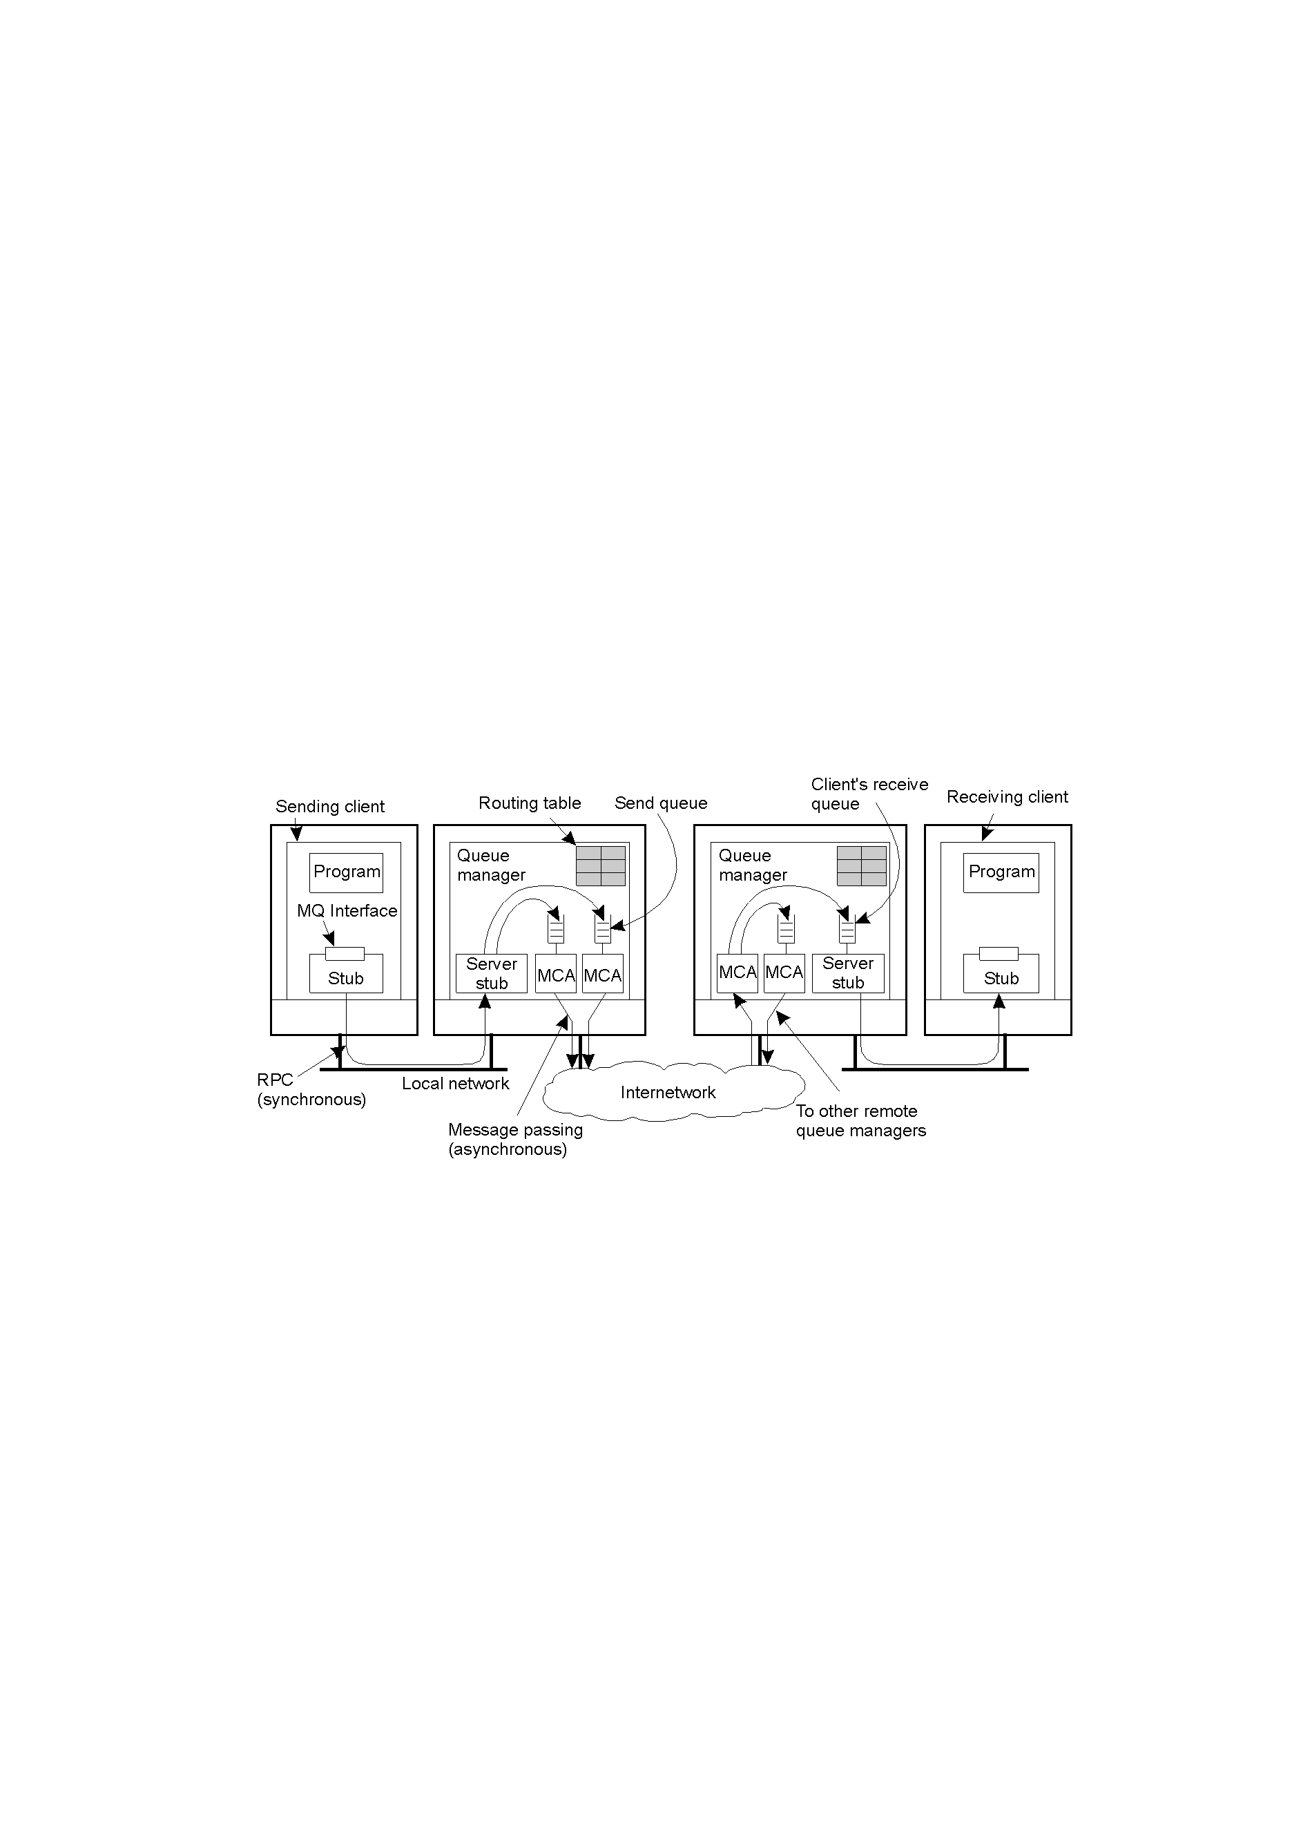
Case Study: IBM MQSeries / WebSphere MQ
General organization of IBM's MQSeries message-queuing system.
MCA: Message Channel Agent
APIs: MQopen, MQput, MQget, MQclose

Slide 67
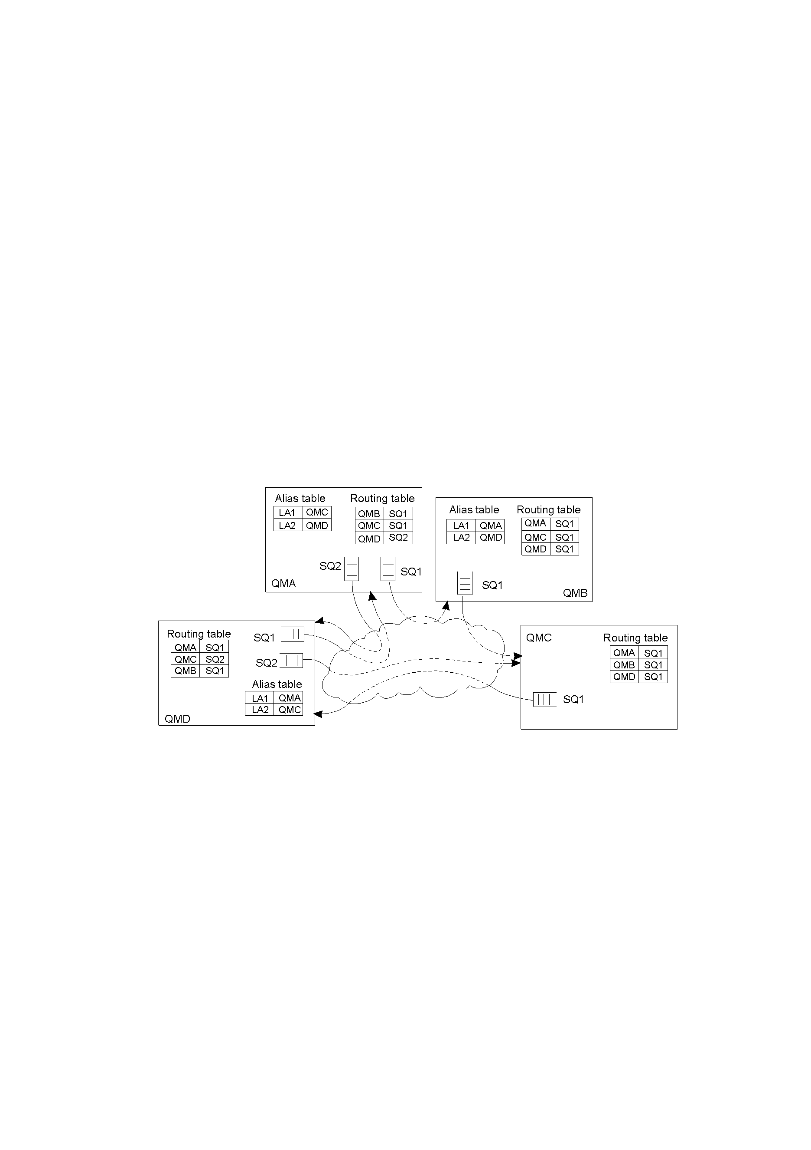
Queue Manager: aliases
Aliases are introduced to deal with rename or replacement of a queue manager
Routing Table:
(destQM, sendQ)
Alias defined within a queue manager M1 is another name for a queue manager M2, but which is available only to applications interfacing to M1.
The general organization of an MQSeries queuing network using routing tables and aliases.

Slide 68
Case Study: Kafka
Producer, consumer, broker
Topic: 相当于队列
高并发：支持数千个客户端同时读写
高吞吐量、低延迟：每秒可以处理几十万条消息，
可伸缩性好：支持消息分区(partition)
提供持久性、可靠性：消息被持久化到本地磁盘，并且支持数据备份防止数据丢失
容错性：允许集群中结点失败(若副本数量为n，则允许n-1个结点失败)
Notes:
一个主题下可以有多个分区，所谓分区策略是决定生产者将消息发送到哪个分区的算法，producer发送的消息分发到不同的partition中，kafka确保每个partition只能 同一个group中的同一个consumer消费

Slide 69
Stream-oriented communication
Stream-oriented communication can exchange time-dependent information such as audio and video streams
Concentrate on continuous multimedia streams using isochronous transmission
Continuous / discrete media
Simple / complex stream
Asynchronous / synchronous / isochronous transmission mode

Slide 70
Quality of Service
Nonfunctional requirements: timeliness, reliability, scalability, extensibility, etc.
as to timeliness during setting up a stream:
The required bit rate at which data should be transported
The maximum delay until a session has been set up
The maximum end-to-end delay
The maximum delay variance, or jitter
The maximum round-trip delay

Slide 71
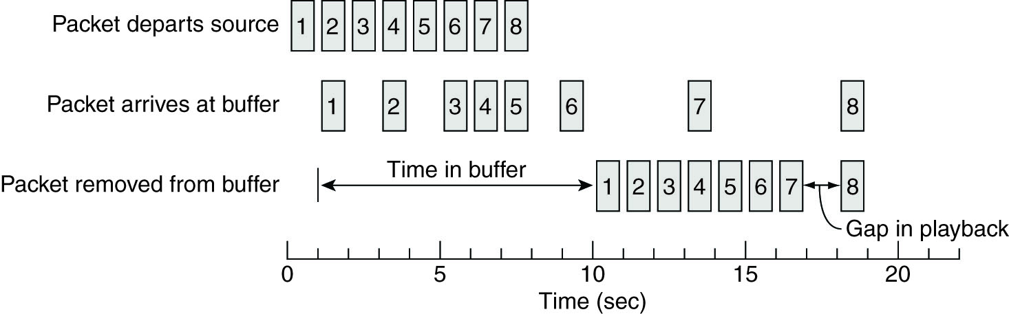
Enforcing QoS-I
IP, the best-effect datagram service, will lose/drop packets
Network-level solutions: differentiated service provided by Internet
Middleware-level solutions: use buffers to reduce jitter

Slide 72
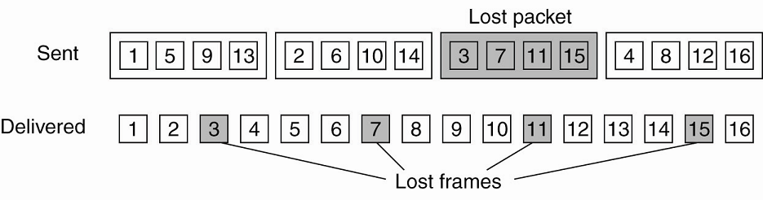
Enforcing QoS- II: Packet loss recovery techniques
Sender-based repair
Active
Passive
Retransmission
Interleaving
Forward error correction
Media-specific
Media-Independent
encode the outgoing packets in such a way that any k out of n received packets is enough to reconstruct k correct packets: parity coding, Reed-Solomon coding

Slide 73
Enforcing QoS- III: error concealment techniques
Receiver-based repair
Insertion
Interpolation
Regeneration
Interpolation of transmitted state
Splicing
Waveform substitution
Time scale modification
Model-based recovery
Packet repetition
Pitch waveform replication
Silence/Noise substitution

Slide 74
Stream Synchronization
Maintain temporal relations between streams
Synchronization between a discrete stream and a continuous one
Synchronization between continuous streams
Lip synchronization
How to synchronize
Achieve lip synchronization by alternating between reading an image and reading a block of audio sample every 33ms (assuming that the images are to be displayed at 30Hz)
Employ synchronization specification, such as the ones in MPEG (Motion Picture Experts Group) standards

